Slide 1



ATRIA INSTITUTE OF TECHNOLOGY
Department of Information Science &Engineering
3rd Semester, Data Structures and Algorithms
“Operations on Stacks”
Submitted By:
Ananya M(!AT22IS011)
Anusha P N(1AT22IS012)
Drishya Dechamma(1AT22IS0)
Madhuchandrika(1AT22IS059)
Under the Guidance of
Dr.Jyoti Metan
Associate Professor
Dept. of ISE,ATRIA I.T.

Slide 2
CONTENTS:
What is Stacks??
Pop() operation
Push() operation
Display() operation
Palindrome() operation
Exit() operation
Is Empty() operation
Is Full() operation

Slide 3
Stack
“A Stack is a linear data structure that holds a linear, ordered sequence of elements. It is an abstract data type. A Stack works on the LIFO process (Last In First Out), i.e., the element that was inserted last will be removed first..”
LIFO
(last in first out)
FILO
(First in last out)
5
9 2 5
5
5
2
2
2
9
9
9

Slide 4

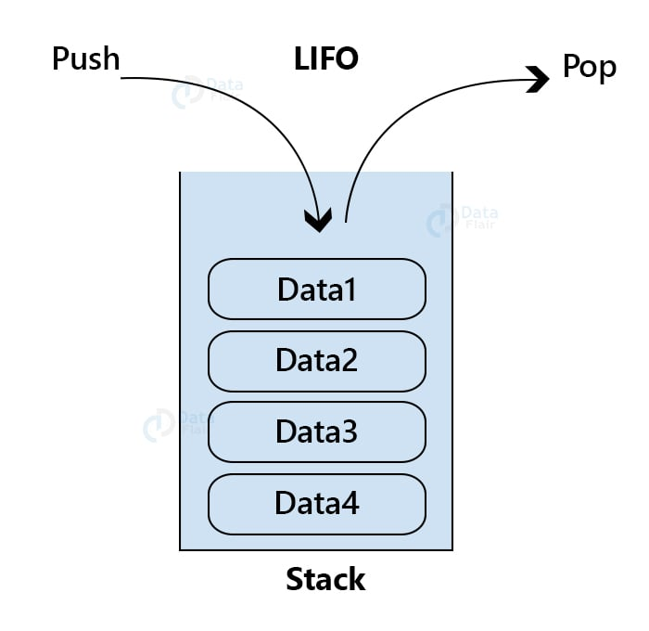

Examples

Slide 5
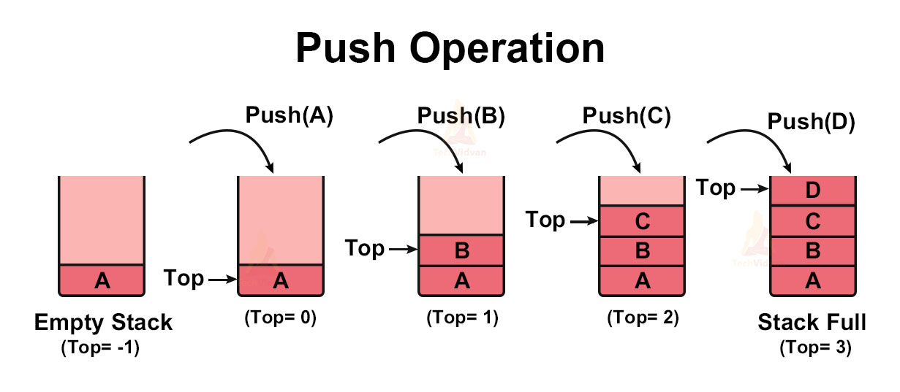
Operations on Stacks
Push():
*Inserts an element onto the stack.
*It first checks whether sufficient space is available then increments the
value of top by 1, and then inserts the item into the stack

Slide 6
Syntax:
void push()
{
int item;
if(top==size-1)
{
printf("Stack overflow \n");
return;
}
printf("Enter an item \n");
scanf("%d",&item);
s[++top]=item;
}

Slide 7
Push()
2
Adds element to the stack
0
6
Modifies the stack
22
12
Stack

Slide 8
#include <stdio.h>
#include<stdlib.h>
#define MAX 5
int stack_arr[MAX];
int first = -1;
void push(int data){
int i;
first += 1;
for(i=first; i=0;i--)
stack_arr[i]= stack_arr[i-1];
stack_arr[0]=data;
}
void print()
{
int i;
if (first==-1){
printf(“stack underflow\n”);
exit(1);
}
for(i=u; i<first; i++)
printf(“%d”,stack_arr[i]);
printf(“\n”);
}
int main()
push(30);
push(90);
print();
return 0;
Output:
90 30
30
0
0
data
i
first
stack_arr
30
0
1
2
3
4
30
1
1
data
i
first
stack_arr
90
0
1
2
3
4

Slide 9
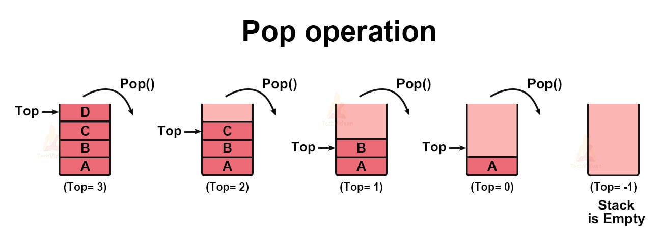
Pop():
*Deleting a data element from the stack is known as pop operation.
*The items are popped in the reversed order in which they are pushed.
If the stack is empty, then it is said to be an Underflow condition.

Slide 10
Syntax:
void pop()
{
if(top==-1)
{
printf("Stack underflow \n");
return;
}
printf("Deleted item=%d“, s[top--]);
}

Slide 11
Pop()
2
Removes element from the stack
15
4
Modifies the stack
9
12
Stack

Slide 12
#include <stdio.h>
#include<stdlib.h>
#define MAX 5
int stack_arr[MAX];
int first = -1;
void push(int data){
int i;
first += 1;
for(i=first; i=0;i--)
stack_arr[i]= stack_arr[i-1];
stack_arr[0]=data;
}
int pop()
int i, value;
value = stack_arr[0];
int main()
int data;
push(30);
push(90);
data = pop();
print();
return 0;
Output:
90 30
for(i=0; i<first; i++)
stack_arr[i] = stack_arr[i+1];
first -= 1;
return value;
void print()
{
int i;
if (first==-1){
printf(“stack underflow\n”);
exit(1);
}
for(i=u; i<first; i++)
printf(“%d”,stack_arr[i]);
printf(“\n”);
}

Slide 13
int pop()
int i, value;
value = stack_arr[0];
for(i=0; i<first; i++)
stack_arr[i] = stack_arr[i+1];
first -= 1;
return value;
2
1
first
1
0
3
stack_arr
3
2
1
i
value
0
1
2
3
4

Slide 14
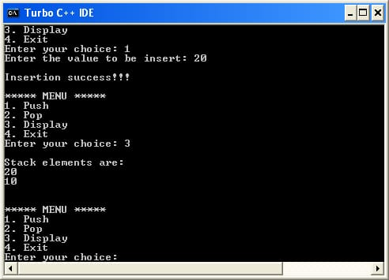
Display():
* Displays/prints the elements of a Stack

Slide 15
Syntax:
Void display ()
{
int i;
If(top==-1)
{
Printf("stack is empty underflow");
Return;
}
Printf("contents of the stack are :\n ");
For ( i=top;i>=0;i--)
printf("%d\n",s[i]);
}

Slide 16
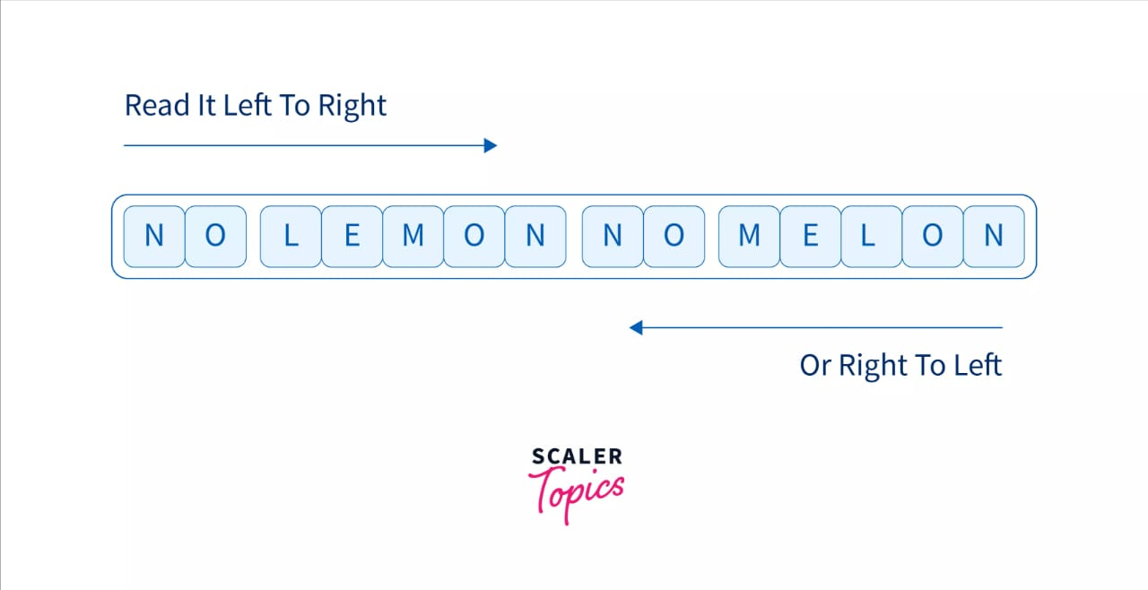
Palindrome():
* Palindrome is defined as a string that is written the same forward and backwards.

Slide 17
Syntax:
void palindrome()
{
int i,count=0;
for(i=0; i<=(top/2); i++)
{
if(stack[i] == stack[top-i])
count++;
}
if((top/2+1)==count)
printf("\n Stack contents are Palindrome");
else
printf("\nStack contents are not palindrome");
}

Slide 18
Exit():
*The exit function terminates the currently running program explicitly which called it.
#include <stdio.h> #include <stdlib.h> int main(){
for(int i=0;i<=7;i++){
if(i==5)
exit(0);
else printf("%d\n",i);}
return 0;
}

Slide 19
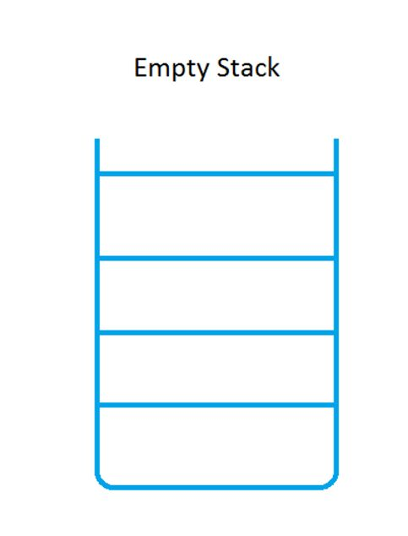
Is Empty():
*Before we delete an item from the stack, we must first check whether
there are any element in the stack.

Slide 20
Example program:
if(top==-1)
{
printf("Stack os empty -Underflow \n");
return;
}

Slide 21
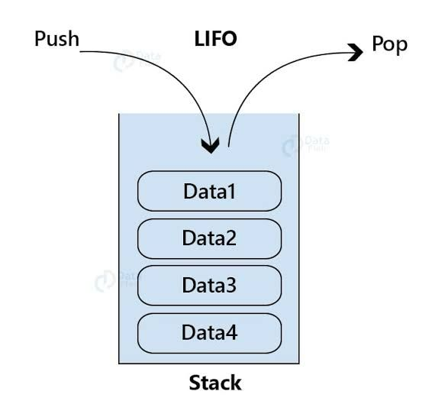
Is Full():
In order to check push operation we need to check whether the stack is completly filled with elements are not.

Slide 22
Example program:
if(top== size-1)
{
printf("Stack is full -Overflow \n");
return;
}

Slide 23
Program in c for operations on stacks
#include<stdio.h>
#define MAX 5
int stack[MAX];
int top=-1;
// Push an Element on to Stack
void push()
{
int item;
// Stack Overflow situations
if(top==(MAX-1))
printf("\n Stack Overflow");
else
{
printf("\n Enter the element to be pushed :");
scanf("%d",&item);
// pushing element to the top of stack
stack[++top]=item;
}
}

Slide 24
// Pop an Element from Stack
void pop()
{
// Stack Underflow situations
if(top==-1)
printf("\n Stack Underflow");
else
printf(" \nPoped element is %d ",stack[top--]); // poping element from the top of stack
}
//Display the status of Stack
void display()
{
int i;
if(top==-1)
printf("\n Sorry Empty Stack");
else
{
printf("\nThe elements of the stack are\n");
for(i=top;i>=0;i--)
printf("stack[%d] = %d\n",i, stack[i]);
}
}

Slide 25
//Demonstrate how Stack can be used to check Palindrome
void palindrome()
{
int i,count=0;
for(i=0; i<=(top/2); i++)
{
if(stack[i] == stack[top-i])
count++;
}
if((top/2+1)==count)
printf("\n Stack contents are Palindrome");
else
printf("\nStack contents are not palindrome");
}
void main()
{
int choice;
while(1)
{
printf("\n STACK OPERATIONS\n");
printf("1.Push\n 2.Pop\n 3.Display\n
4.Palindrome\n 5.Exit\n");
printf("Enter your choice\n");
scanf("%d",&choice);
}
}

Slide 26
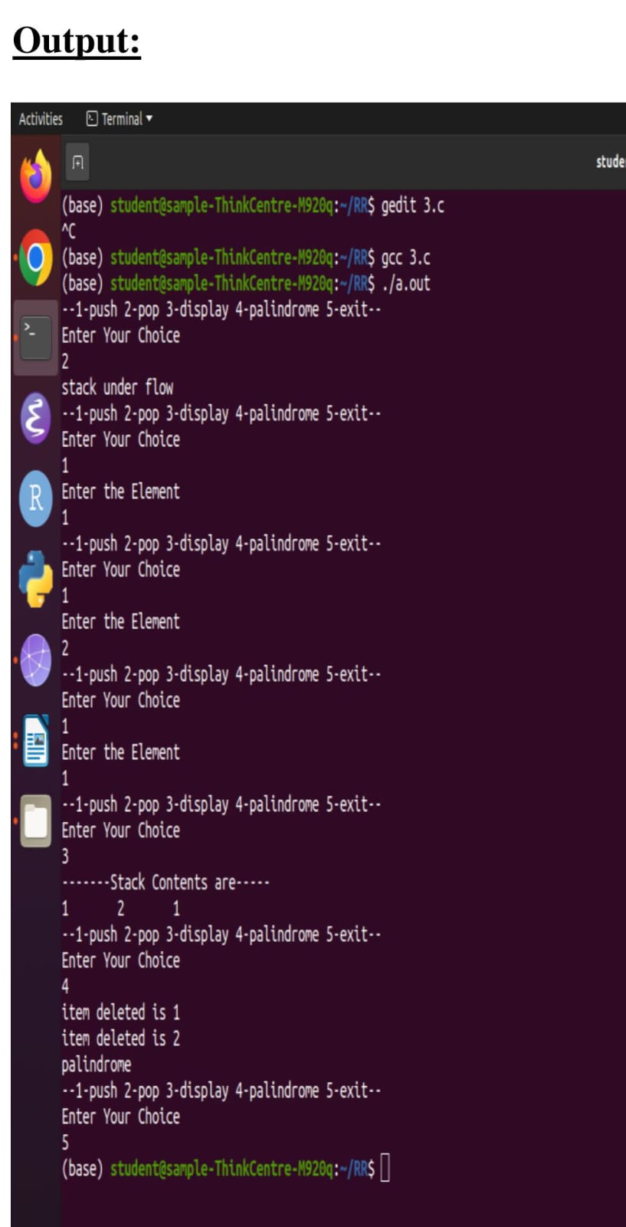
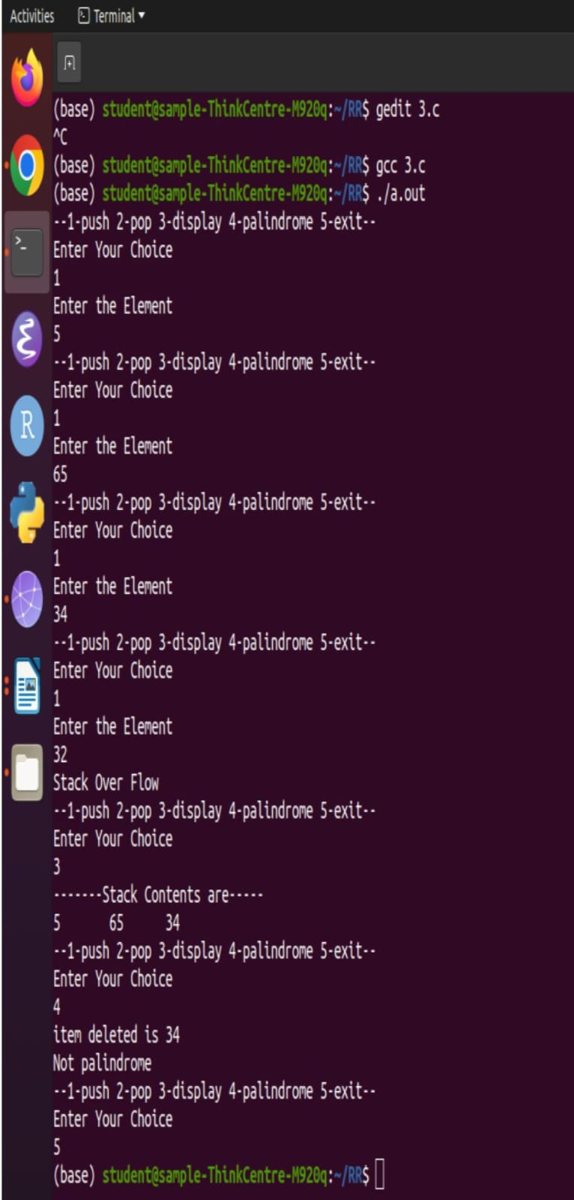
switch(choice)
{
case 1:push();
break;
case 2:pop();
break;
case 3:display();
break;
case 4:palindrome();
break;
case 5:return;
default: printf("Invalid choice\n");
}

Slide 27
THANK YOU!!!!

